Slide 1

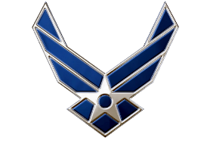
Fall 2024 Staff
Air Force ROTC Detachment 842
The University of Texas at San Antonio
23 Aug 24

Slide 2


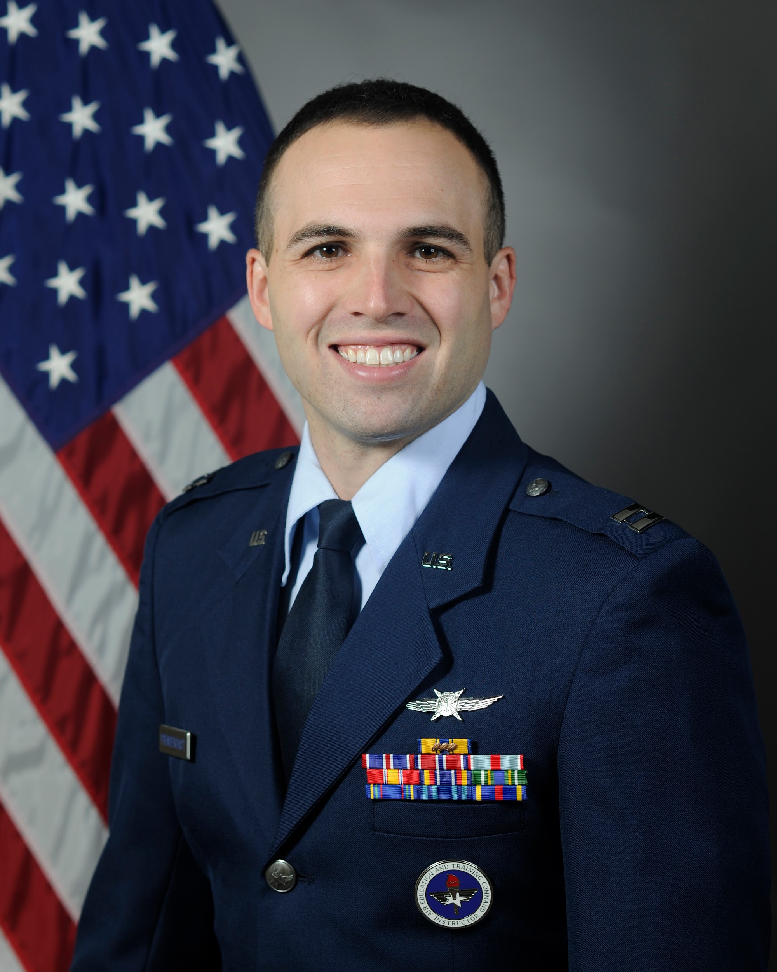
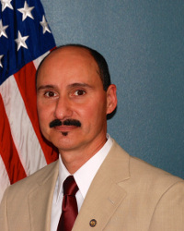
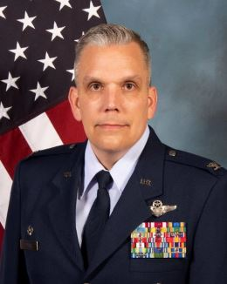
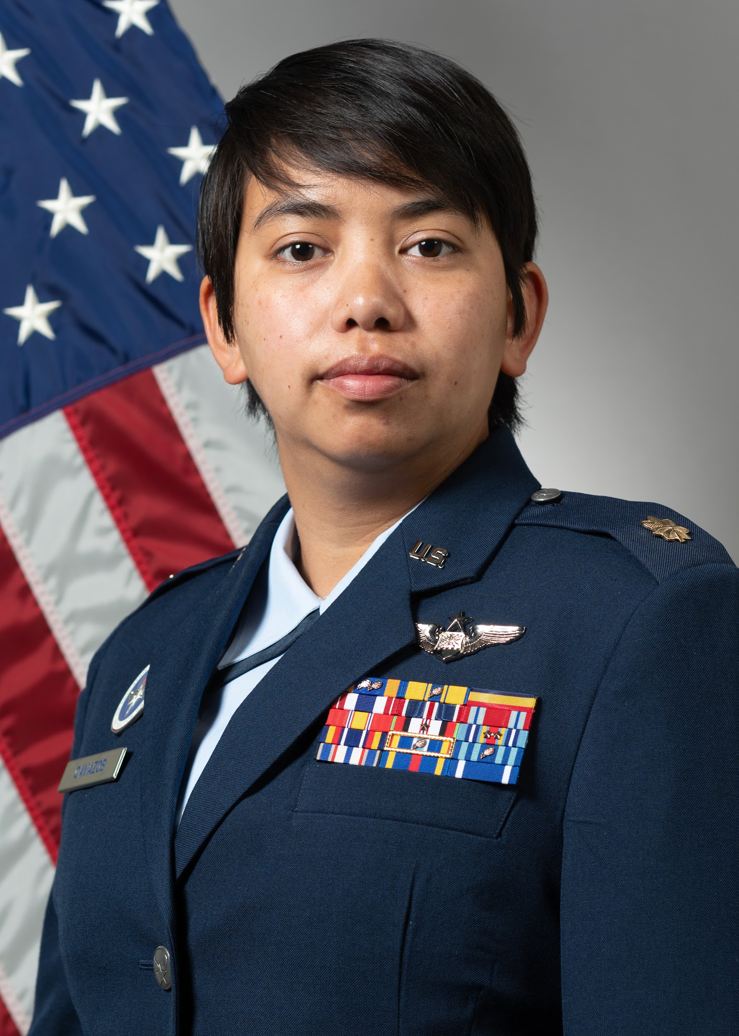
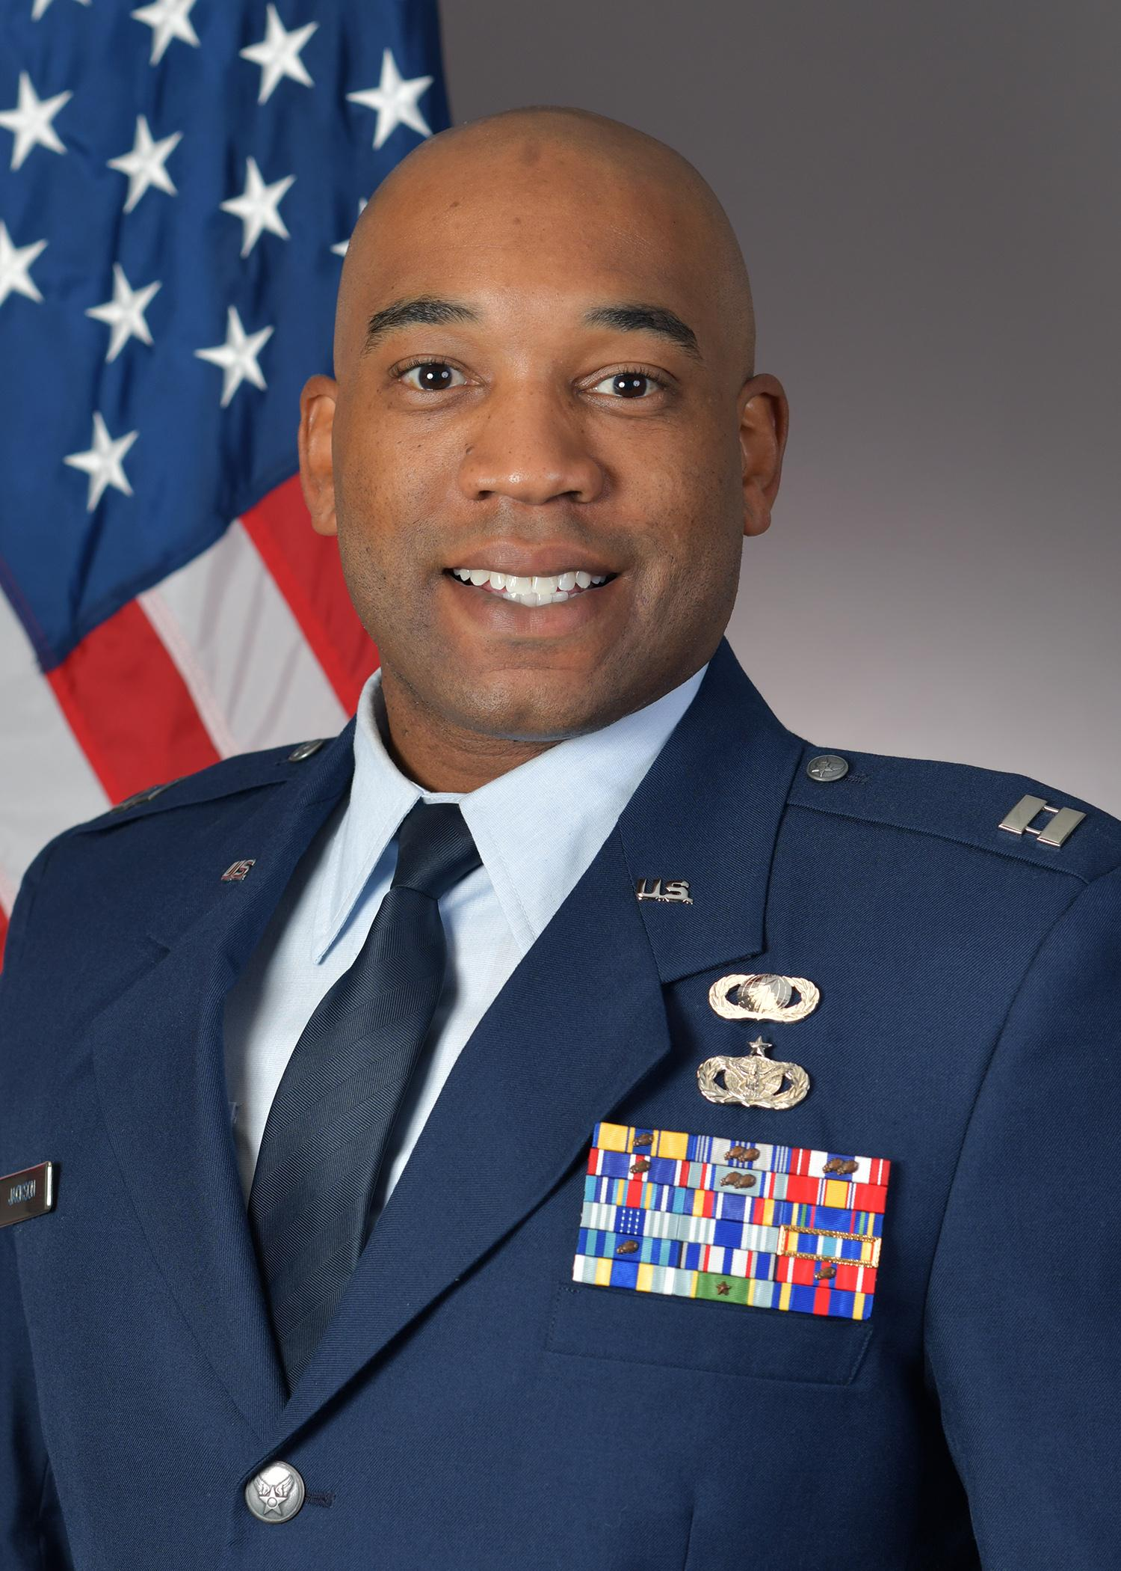
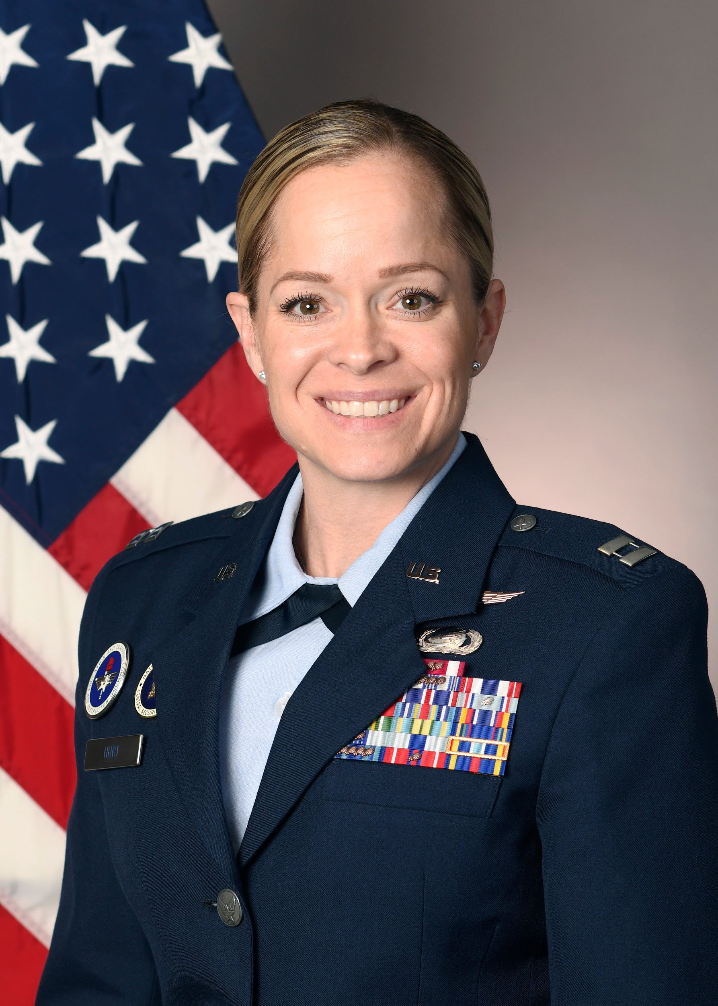
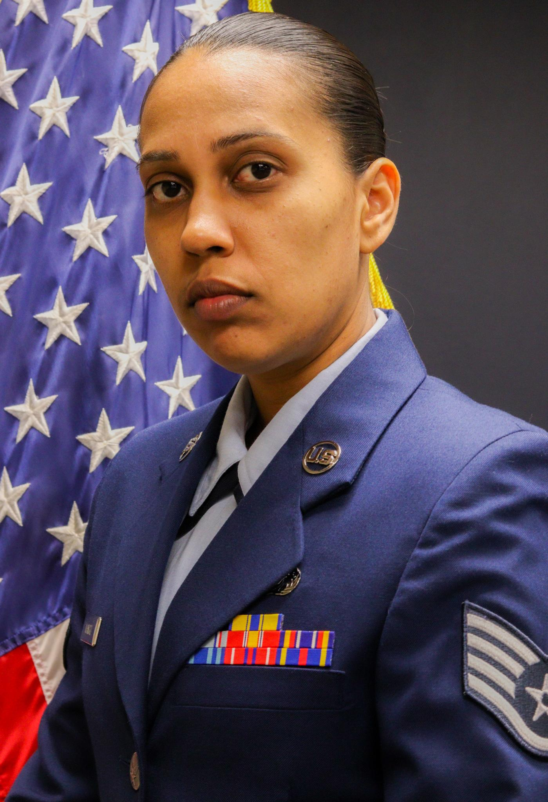
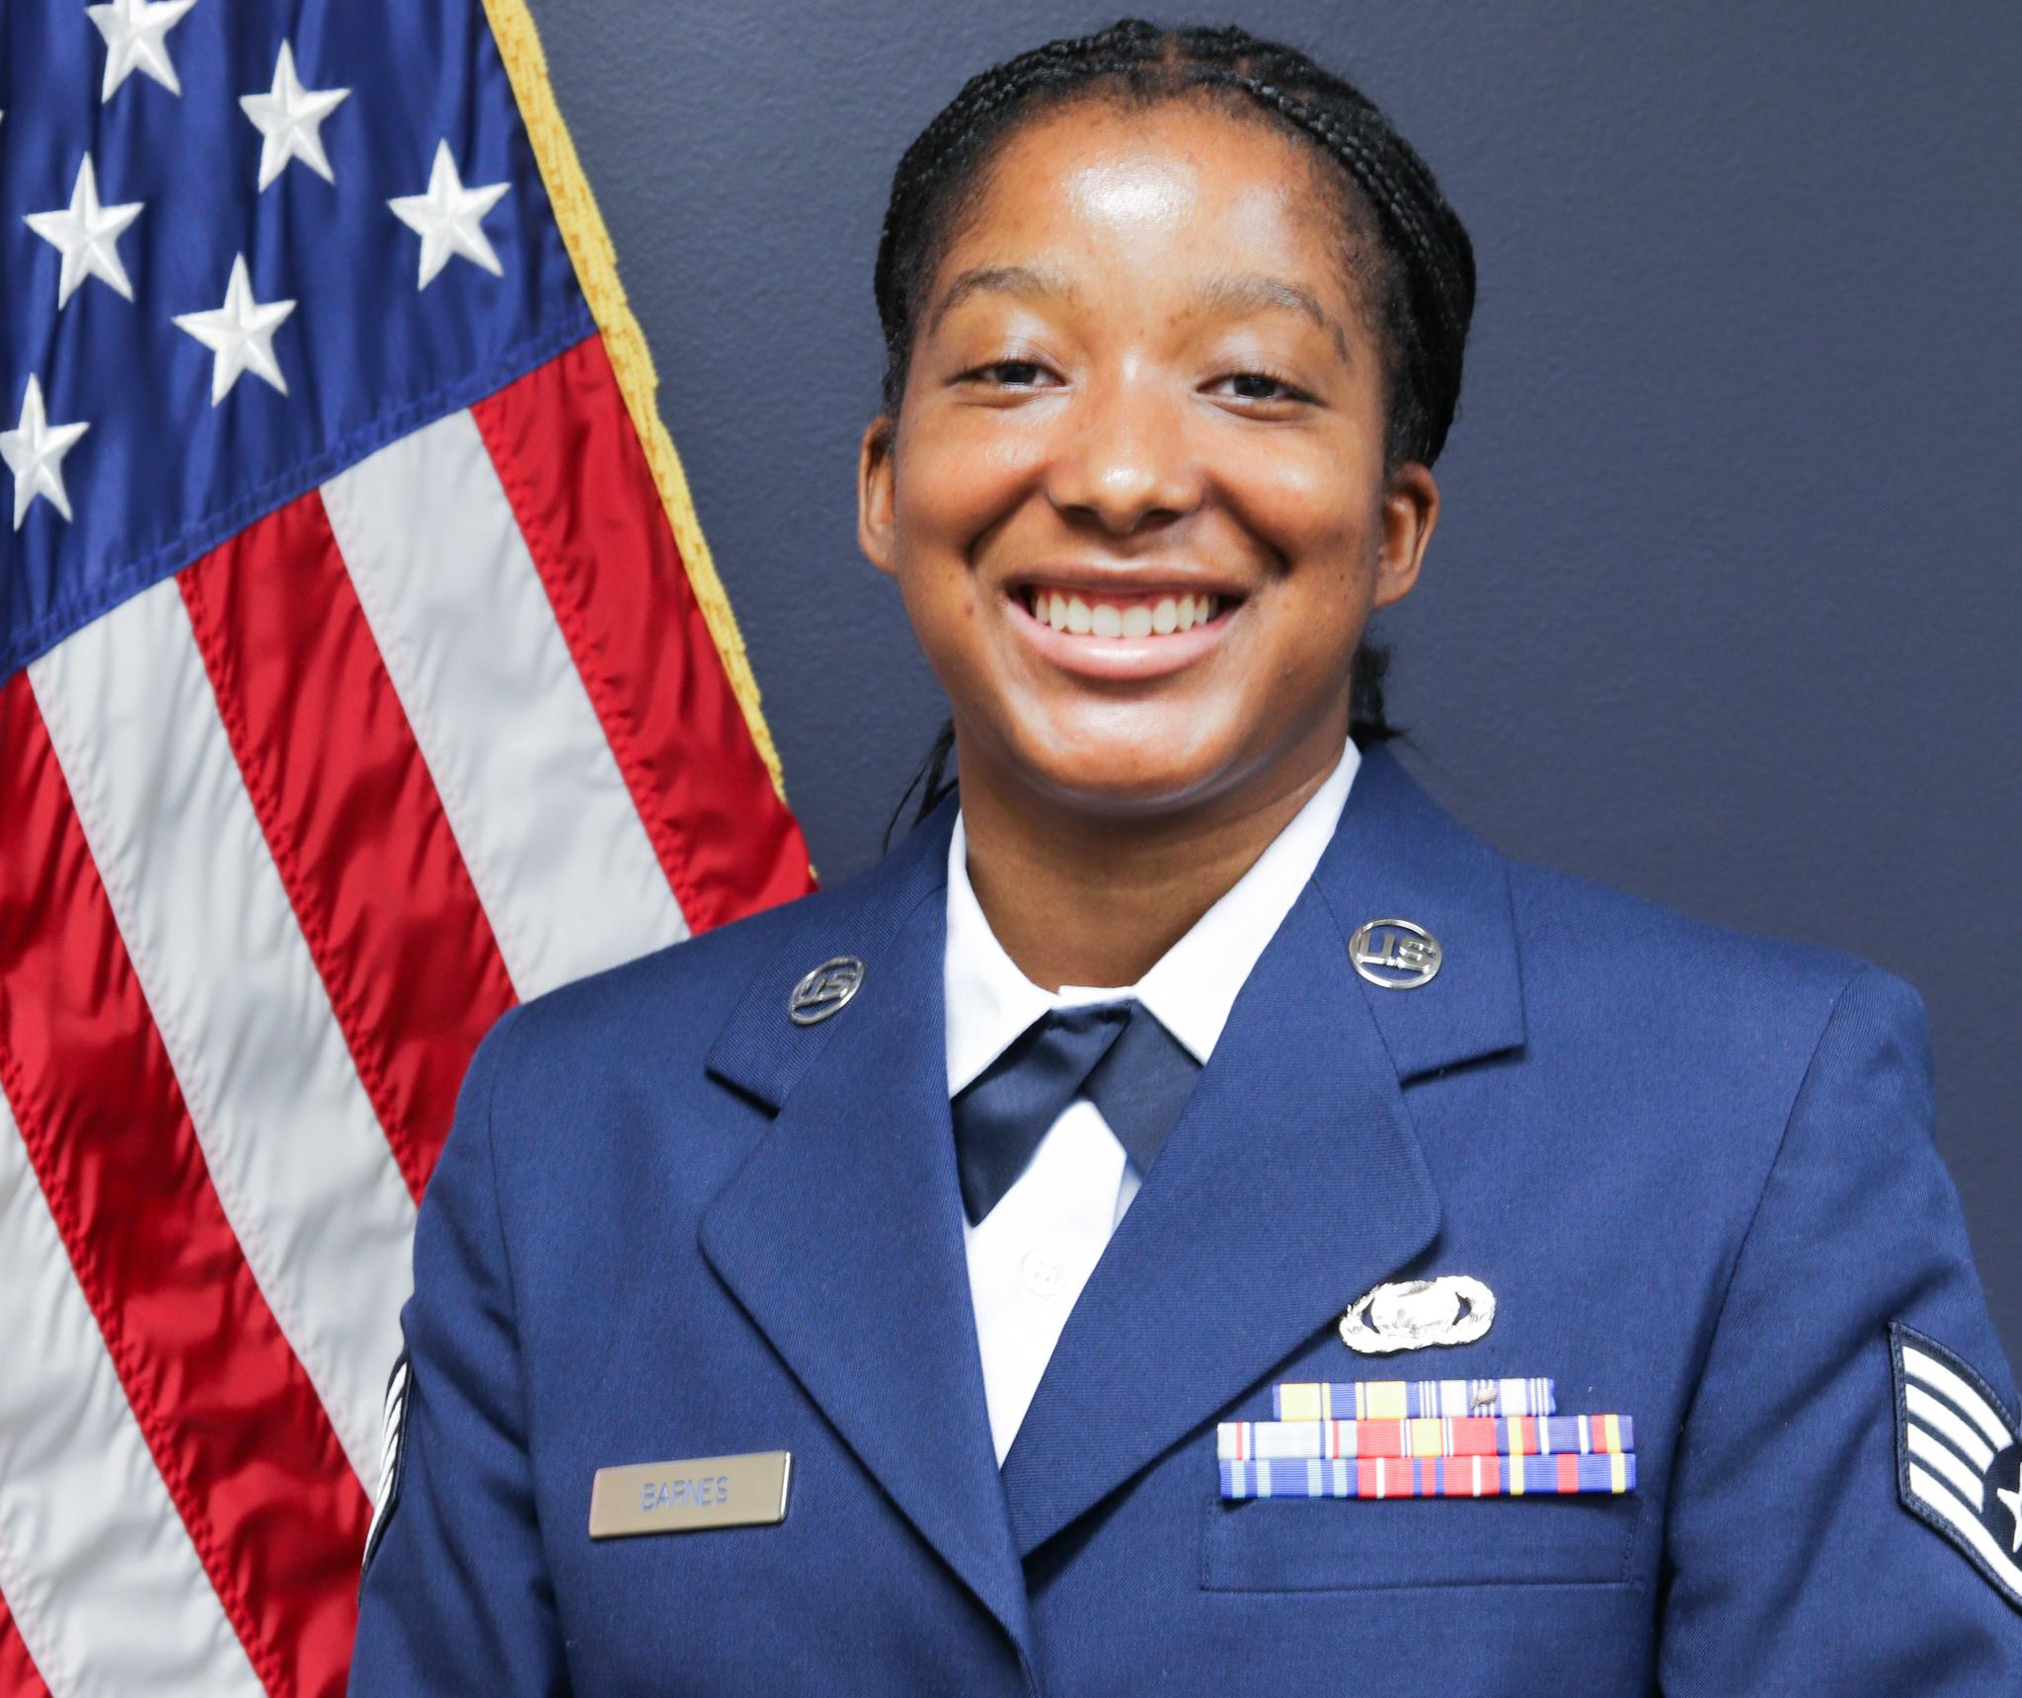
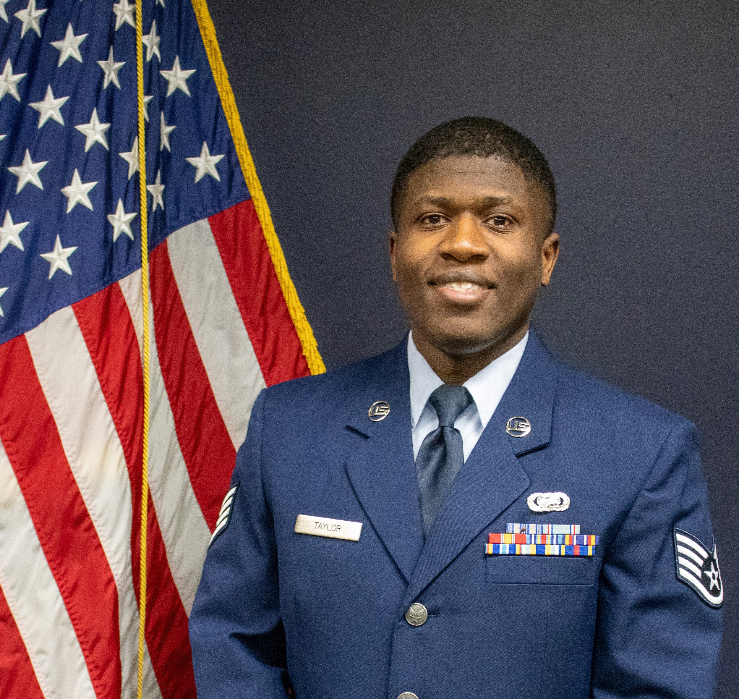
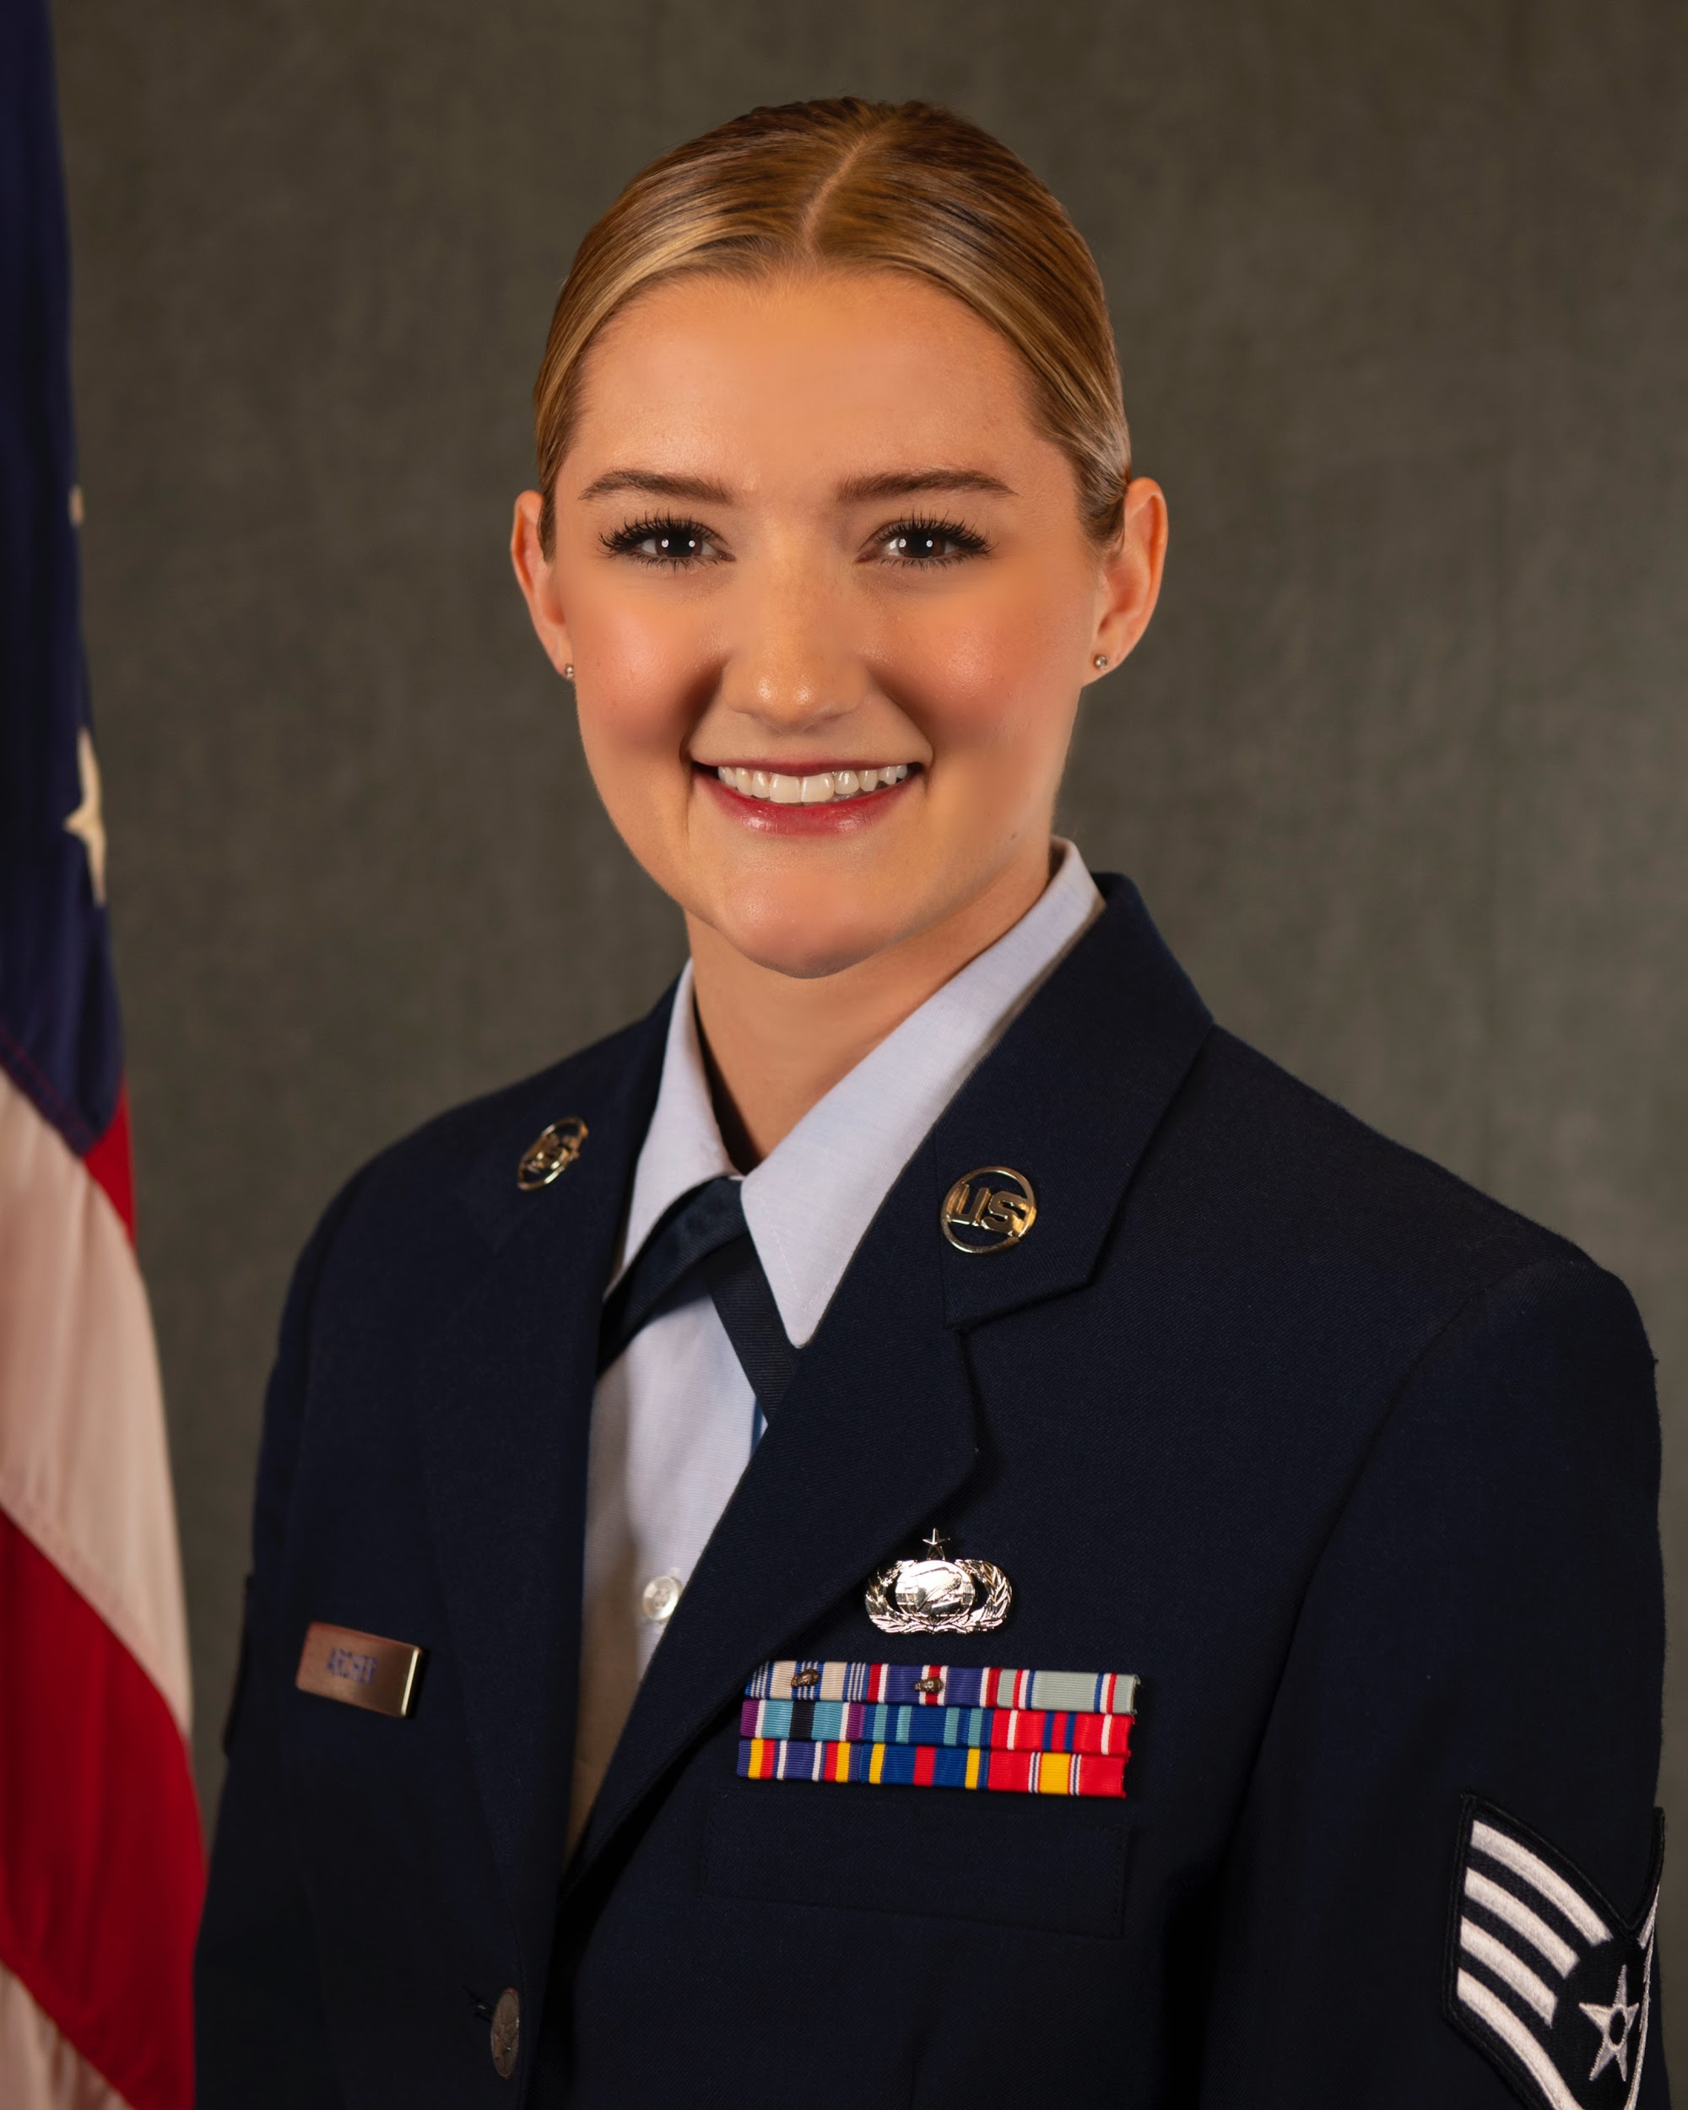
Fall 2024 Cadre
Captain Landon Prendergast
Operations Flight Commander
Mr. Agustin Llano
Program Manager
Colonel Gregory Cyrus
Detachment 842 Commander
Major Tina Cavazos
Director of Operations
Captain Steffon Jackson
Recruiting Flight Commander
Captain Jennifer Hurt
Education Flight Commander
Staff Sergeant Rachel Mangru
ROTC Instructor
Technical Sergeant Erren Barnes
Senior Enlisted Leader
Staff Sergeant Rashaad Taylor
NCOIC, Cadet Actions
Staff Sergeant Paige Archer
NCOIC, Administration
Air Force ROTC Detachment 842 • We Build Exceptional Officers • The University of Texas at San Antonio

Slide 3
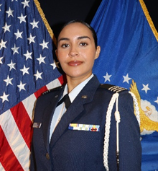
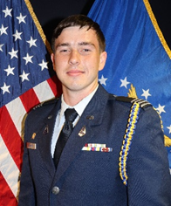
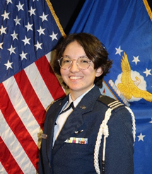
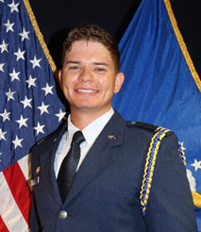
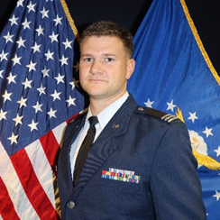
Fall 2024 Wingstaff
Cadet Colonel Shelby Schrecker
Wing Commander
Cadet Colonel Joshua Davidson
Chief of Staff
Cadet Lt. Colonel Mary Vallor
Deputy Commander of Operations
Cadet Lt. Colonel Cody Funke
Deputy Commander of Combat Support
Cadet Lt. Colonel Connor Griffin
Inspector General
Air Force ROTC Detachment 842 • We Build Exceptional Officers • The University of Texas at San Antonio

Slide 4
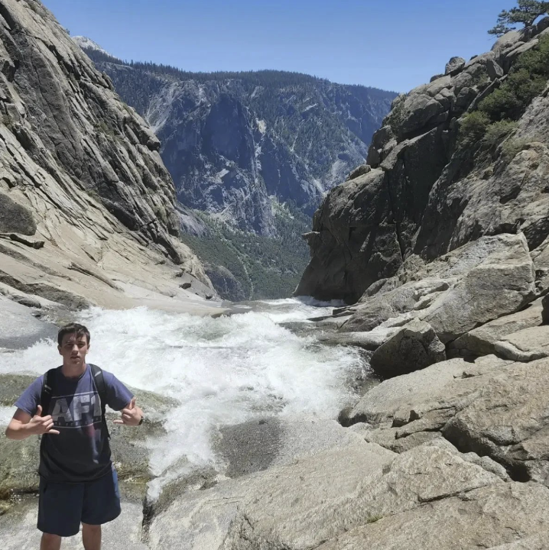
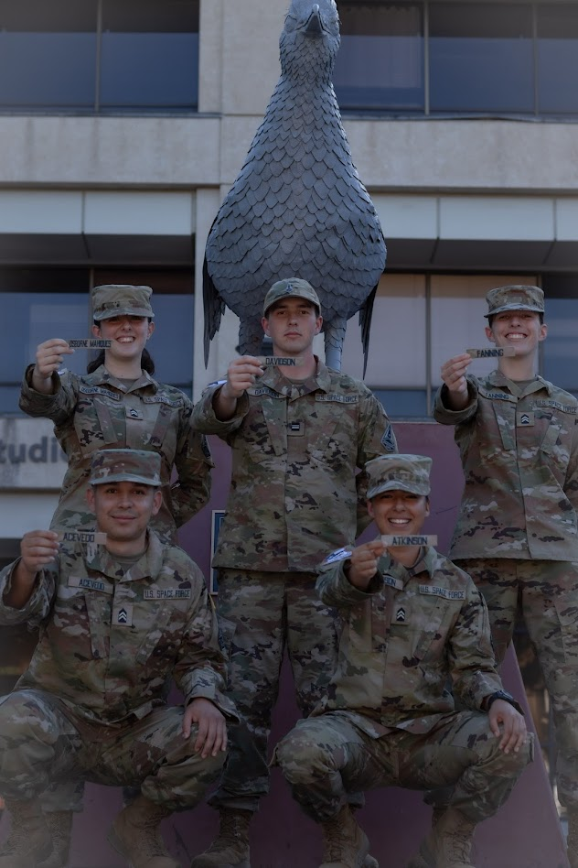
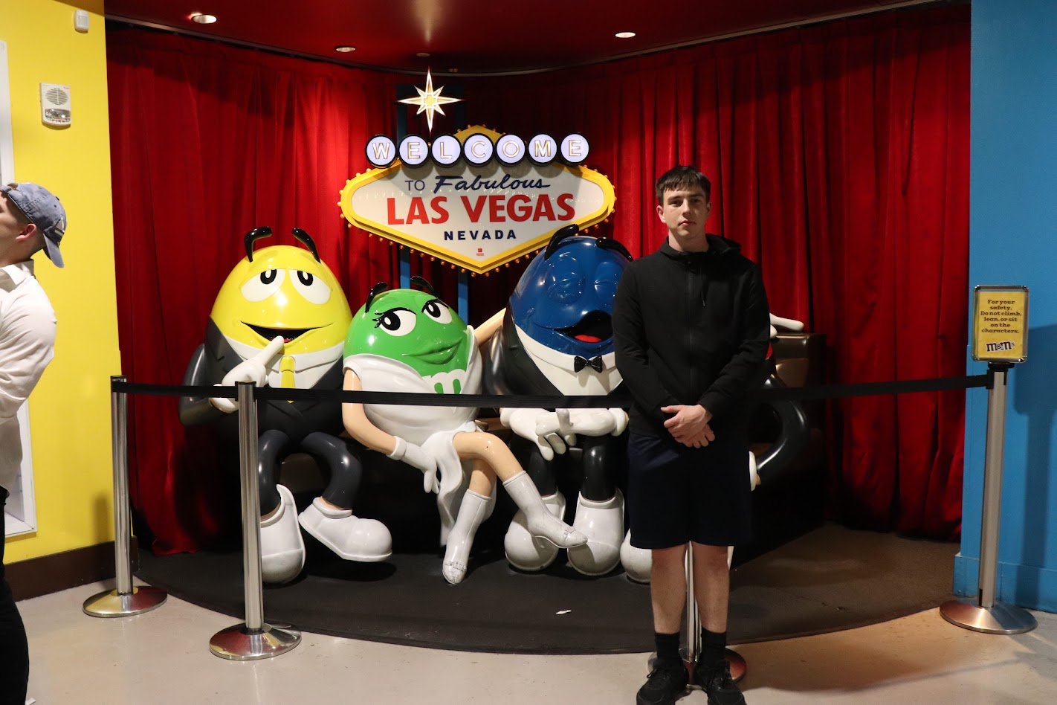
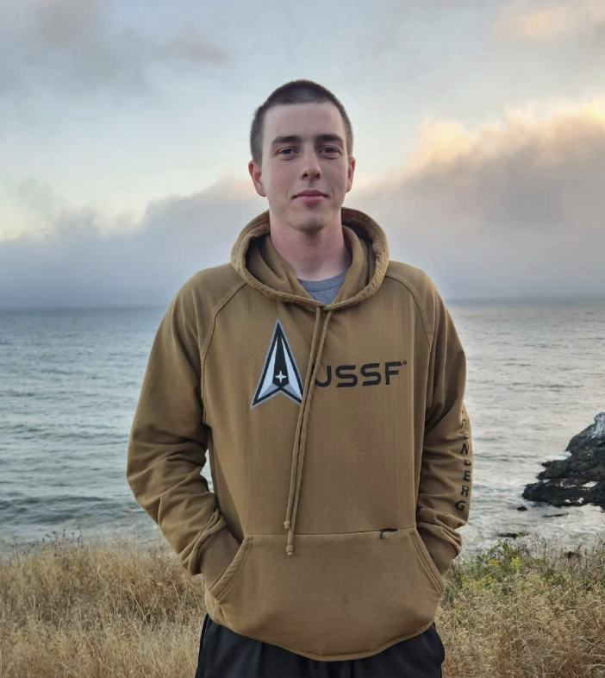
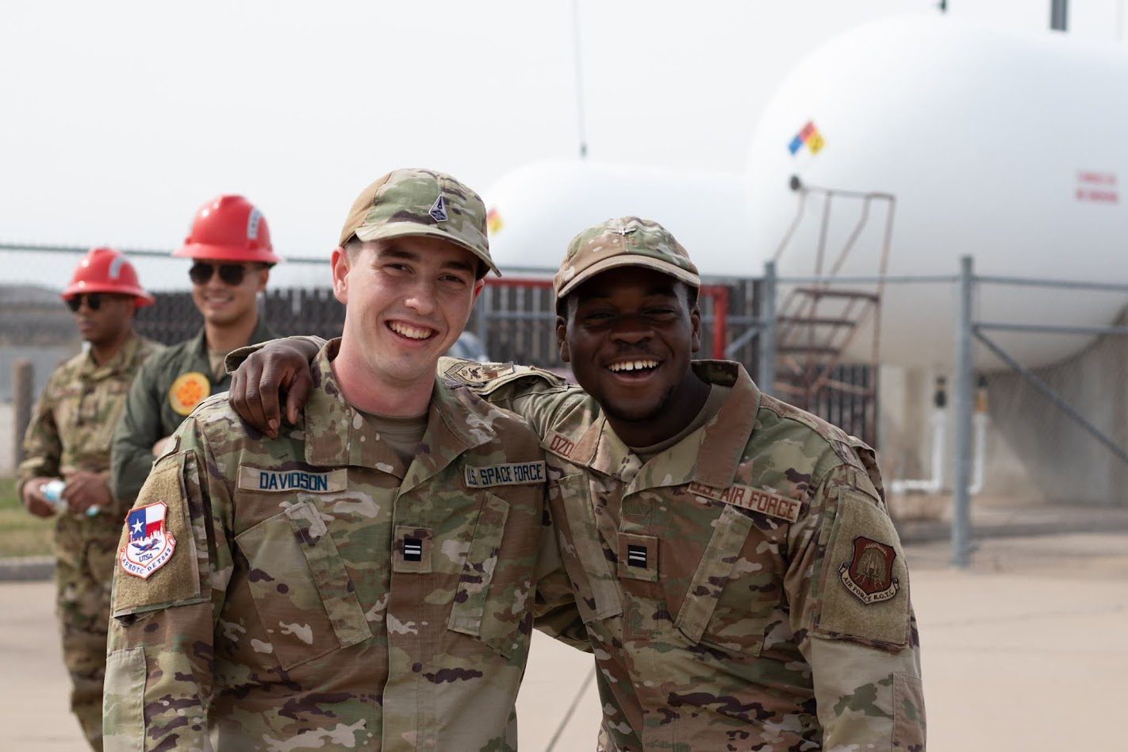
Wing COS - Joshua Davidson
From SATX
Cyber Major
Desired SFSC: Cyber
Favorite Hobbies: Archery,
Cooking, Running, Travel,
Baking

Slide 5
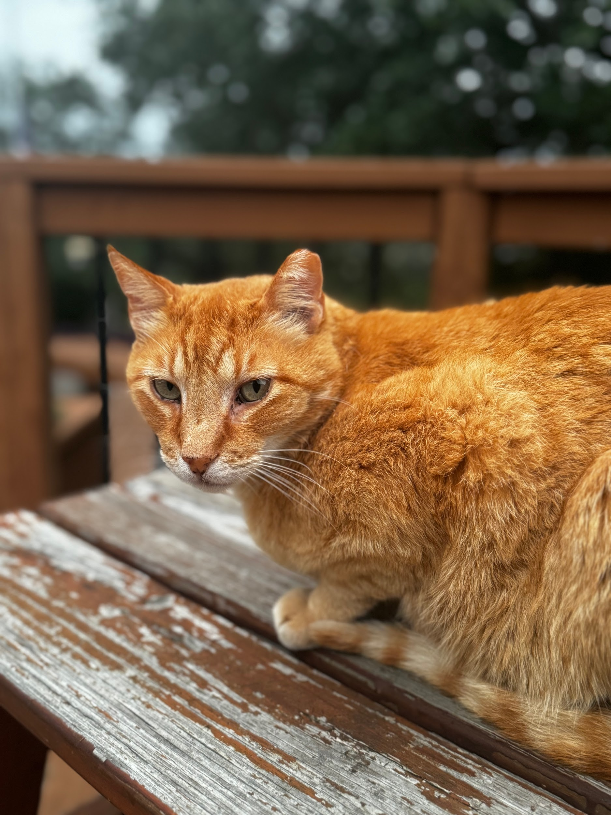
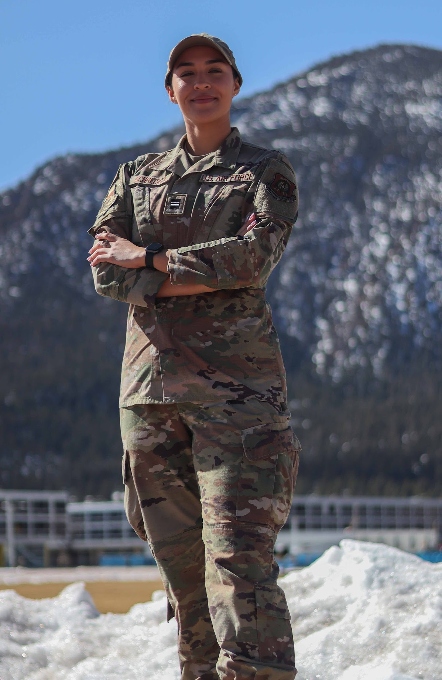
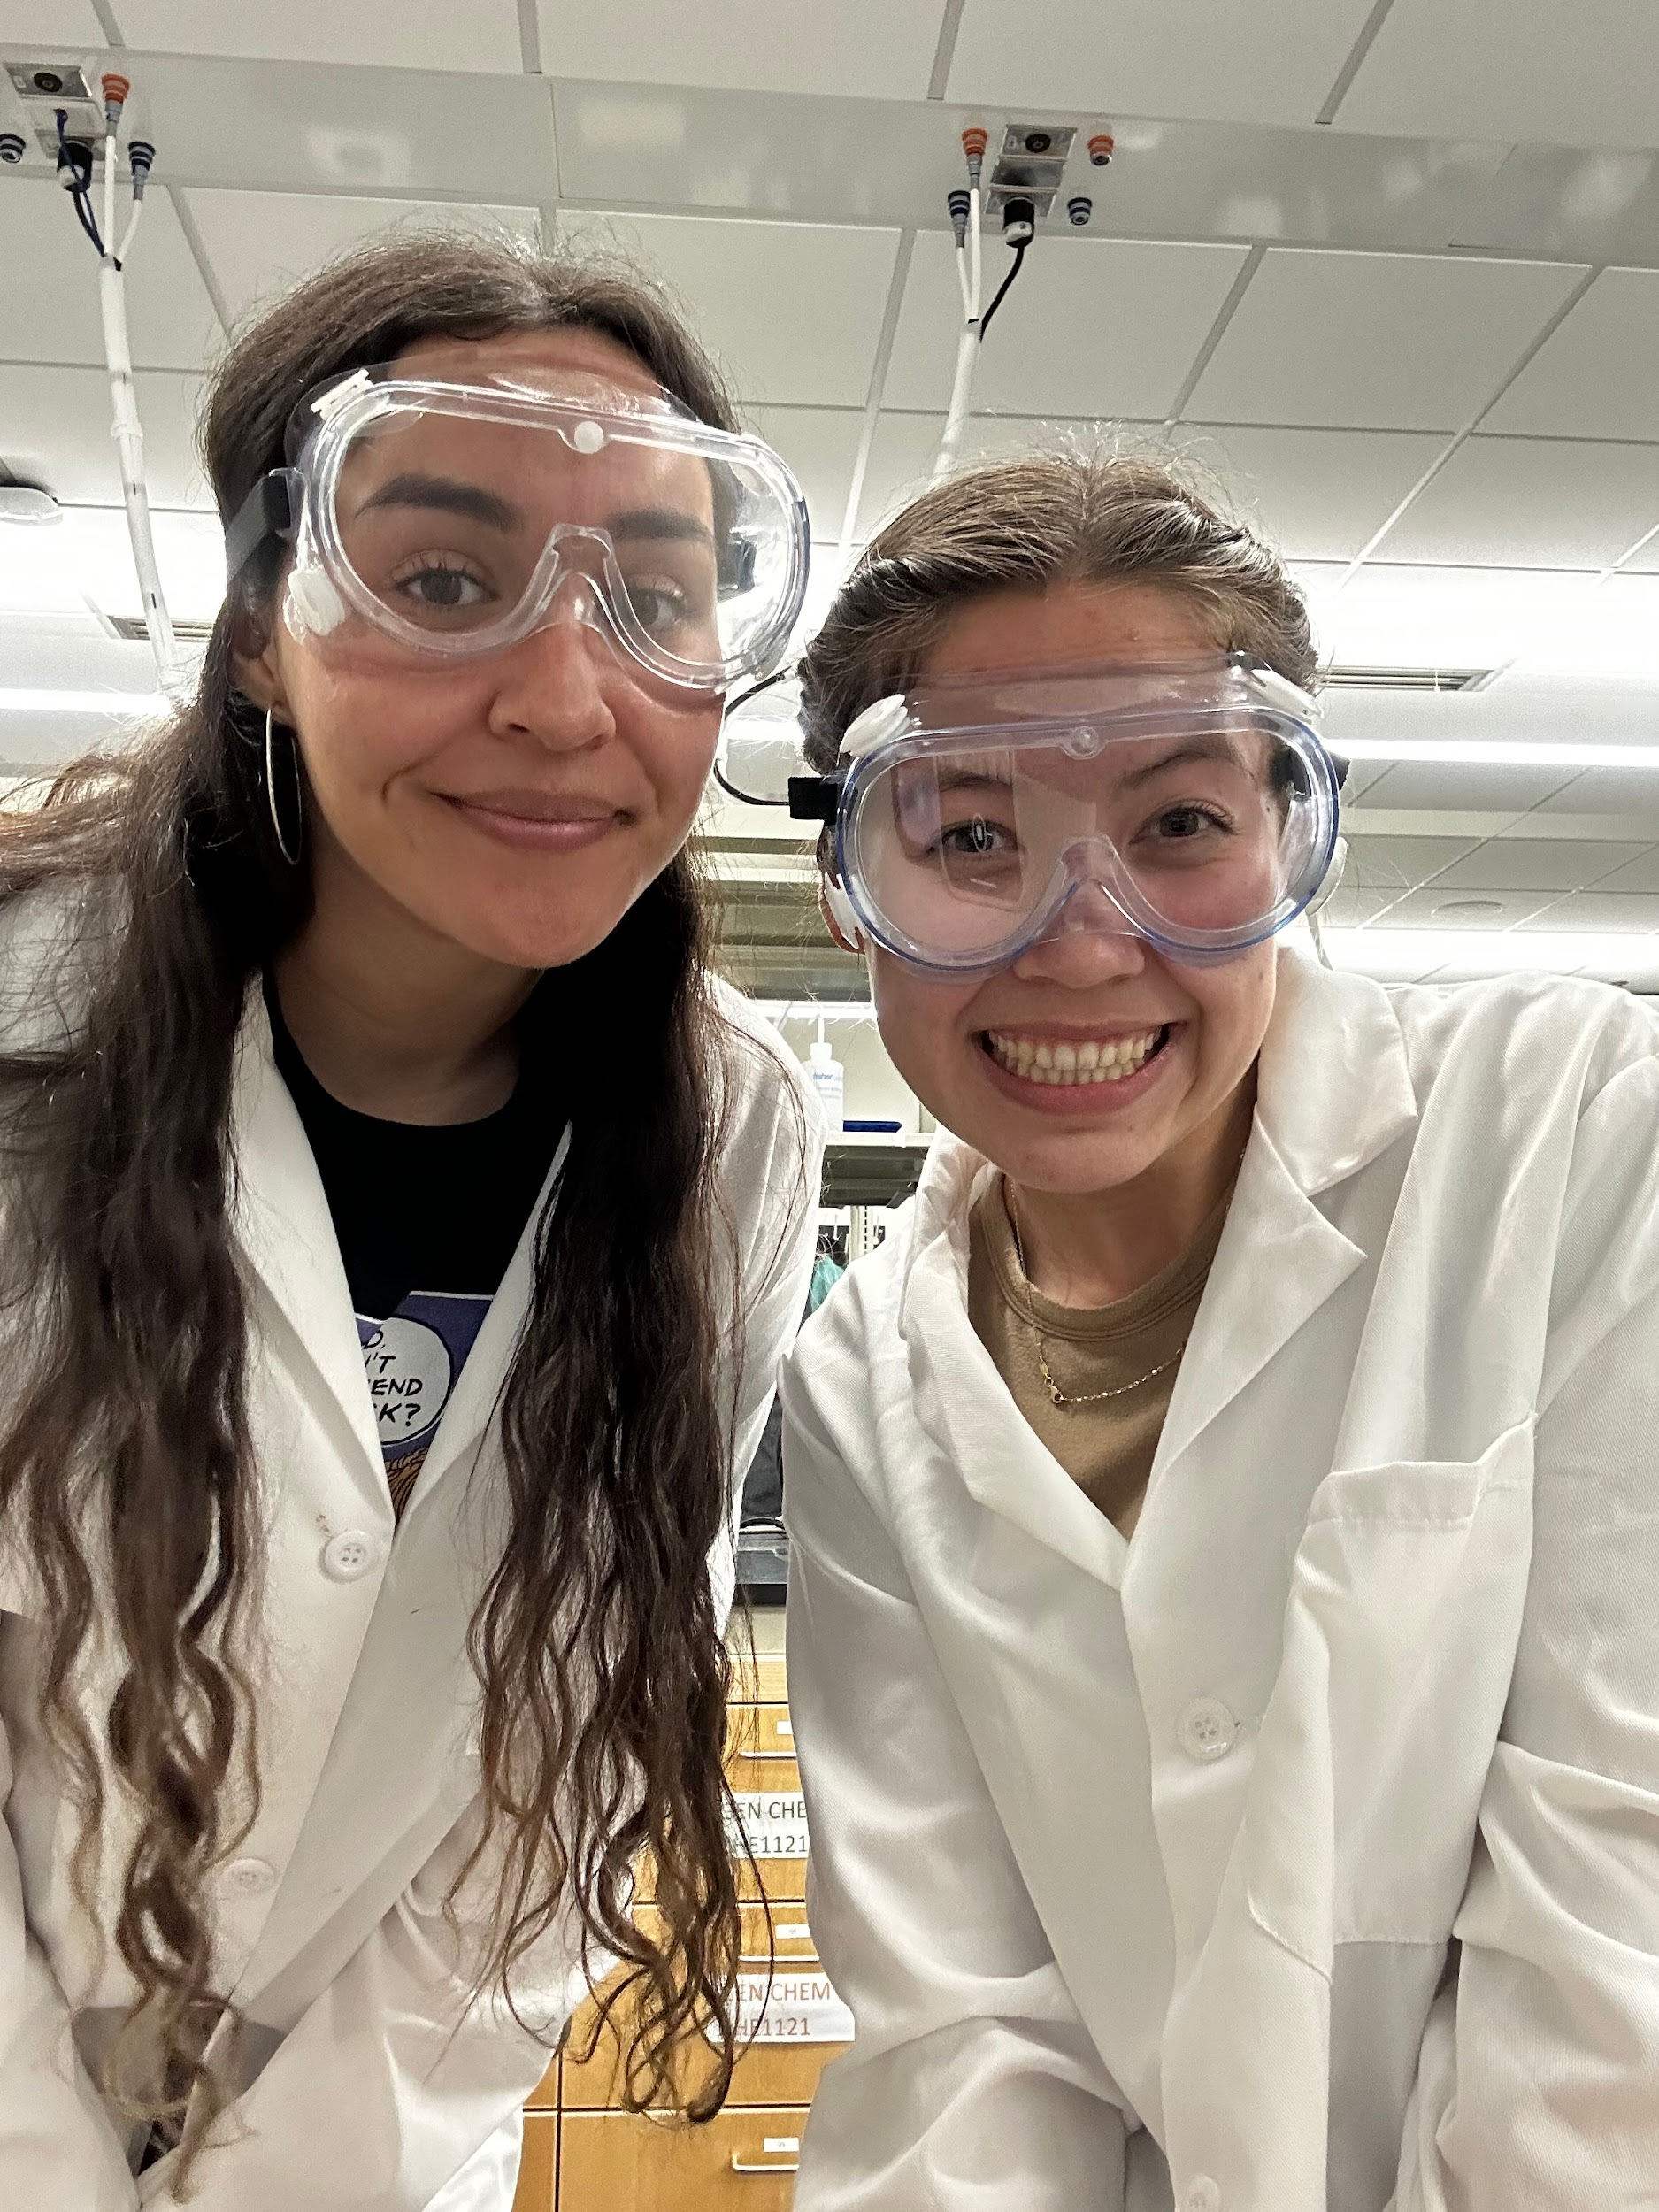
Wing CC - Shelby Schrecker
From SATX
Biology Major with Pre-Medical Concentration
Desired AFSC: Physician
Favorite Things: Cats, Travel, Running, Motorcycles
Notes:
Good Afternoon everyone,
I am Cadet Colonel Schrecker, your Fall 2024 Wing Commander, and it is my absolute honor to welcome you to what promises to be an incredible journey in Air Force ROTC. As your Wing Commander, I am here to support you, guide you, and challenge you as we all strive for excellence together.
This semester, you’ll begin a truly unique and transformative experience that goes beyond the just being a college student. You will learn leadership, teamwork, and discipline— all skills that will not only serve you well in ROTC but throughout your entire life. I remember my own NSOP and the mix of excitement and nervousness I felt but trust me when I say that what you’re feeling now is perfectly normal and part of the journey.
This semester I encourage you to embrace every challenge and opportunity that comes your way. Lean on your fellow cadets, ask questions, and never hesitate to seek help when you need it. And the biggest piece of advice I can offer you all is to show up everyday with an open mind and a willingness to learn – whether you were previously enlisted, did jrotc, or have no military background at all I promise this program is going to be different from anything you have experienced so to succeed all of you are going to need to be open to change and receptive to new information.
With that said, let’s make this semester one of growth, camaraderie, and achievement. I am excited to work with each of you and see all that we can accomplish together.
Welcome to the Det 842 Family!
Thank you.

Slide 6


Inspector General (IG)
Function:​
Safeguard that good ORDER and DISCIPLINE is being upheld in the detachment.​
Ensure the HEALTH and WELLBEING of all cadets within the detachment.​
Steps to take before IG intervention:​
Address the problem/situation at the base level.​
Route the problem/situation up to your immediate supervisor.​
Reach out to the next highest level in the chain of command.​
Submit an IG Complaint​
In the case of a personal matter and wish to speak to someone who is not in your chain, you may also submit an IG Complaint or speak to Cadre directly.​
​
Cadre is only involved at the cadet’s request.​
Air Force ROTC Detachment 842 • We Build Exceptional Officers • The University of Texas at San Antonio

Slide 7
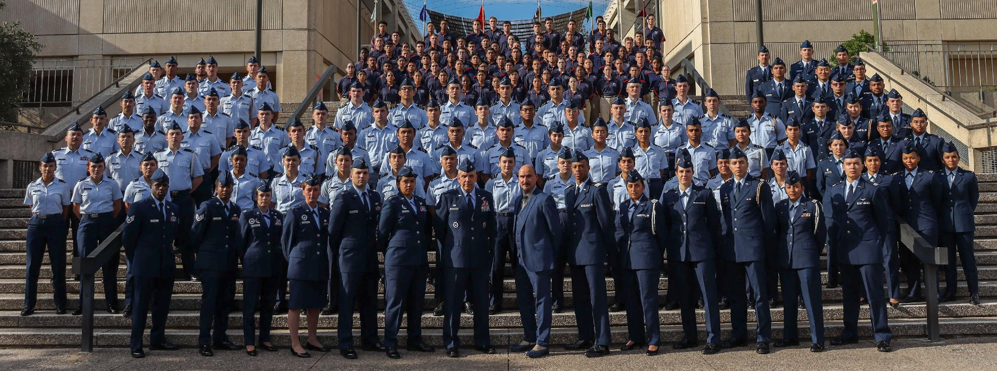
Air Force ROTC Detachment 842
The University of Texas at San Antonio
Det 842 – Best in Blue

